Slide 1


Slide 2
Agenda
Exception Handling
  Unchecked Exceptions
  Checked Exceptions
  The try-catch block
  Multiple catch block
  The finally block
  The throws keyword.

Slide 3
Exceptions
An Exception is an abnormal condition.
It’s an event that disrupts the normal flow of the program.
There are two types of exceptions.
  Checked Exceptions
  Unchecked Exceptions
Exception
Checked
Unchecked
‹#›

Slide 4
Unchecked Exceptions
These are the exceptions that are not checked at compile time.
Exceptions under Error and RuntimeException classes are unchecked exceptions, everything else under throwable is checked.
Examples:
  ArithmeticException
  NullPointerException
  NumberFormatException
  ArrayIndexOutOfBoundsException
‹#›

Slide 5
Common Unchecked Exceptions
int a=50/0
ArithmeticException
String s=null;
System.out.println(s.length());
NullPointerException
String s="abc";
int i=Integer.parseInt(s);
NumberFormatException
int a[]=new int[5];
a[10]=50;
ArrayIndexOutOfBoundsException
‹#›

Slide 6
Checked Exceptions
These are the exceptions that are checked at compile time.
If some code within a method throws a checked exception, then the method must either handle the exception or specify the exception using the throws keyword.
Examples:
  InterruptedException
  IOException
  FileNotFoundException.
‹#›

Slide 7
Common Checked Exceptions
Thread.sleep(3000);
InterruptedException
FileReader fr = new FileReader("C:\\Test.txt");
BufferedReader bfr = new BufferedReader(fr);
System.out.println(bfr.readLine());
FileNotFoundException
IOException
‹#›

Slide 8
Exception Handling Keywords
try
catch
finally
throws
‹#›

Slide 9
try..catch block
The try block is used to enclose code that might throw an exception.
It must be applied at the statement level within the method.
It can be used with either a catch or a finally block or both.
It is used for unchecked and checked Exceptions.
The catch block is used to handle the Exception. It must be used after the try block only.
Multiple catch blocks could come after a single try block.
Syntax of java try-catch
try{
/* code that may throw exception */
}
catch (Exception ex){
/* recovery code */
}
‹#›

Slide 10
Problem without Exception handling
Output: Exception in thread main java.lang.ArithmeticException:/ by zero
class Test{
public static void main(String args[]) {
int data=50/0; /* throw an exception */
System.out.println("rest of the code...");
}
}
‹#›

Slide 11
Solution with Exception handling
Output: Exception in thread main java.lang.ArithmeticException:/ by zero
rest of the code...
class Test{
public static void main(String args[]){
try{
int data=50/0;
}
catch(ArithmeticException e) {
System.out.println(e);
}
System.out.println("rest of the code...");
}
}
‹#›

Slide 12
Multiple catch blocks
If you have to perform different tasks at the occurrence of different Exceptions then use multiple catch blocks.
class Test{
public static void main(String args[]){
try{
int a[] = new int[5];
a[5] = 30/0;
}
catch(ArithmeticException e){ System.out.println("task 1 is completed");}
catch(ArrayIndexOutOfBoundsException e){System.out.println("task 2 completed");}
catch(Exception e){System.out.println("common task completed");}
System.out.println("rest of the code...");
}
}
Output: task 1 completed
rest of the code...
‹#›

Slide 13
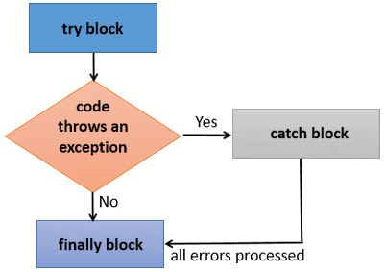
The finally block
The finally block is always executed whether the Exception is handled or not.
It follows the try or the catch block.
It is typically used to execute code to close DB connections, streams, or any other resources opened in the try block. Resources need to be closed to avoid memory leaks.
‹#›

Slide 14
The finally block
The finally block runs when:
  The Exception doesn't occur.
  The Exception occurs and is not handled.
  The Exception occurs and is handled.
In other words, the finally block runs always.
‹#›

Slide 15
The finally block
Example 1: The exception doesn't occur.
class Test{
public static void main(String args[]) {
try{
int data=25/5;
System.out.println(data);
}
catch(NullPointerException e) {
System.out.println(e);
}
finally {
System.out.println("The finally block is always executed");
}
System.out.println("rest of the code...");
}
}
Output:
5
The finally block is always executed
rest of the code...
‹#›

Slide 16
The finally block
Example 2: The exception occurs and is not handled.
class Test{
public static void main(String args[]){
try{
int data=25/0;
System.out.println(data);
}
catch(NullPointerException e) {
System.out.println(e);
}
finally {
System.out.println("The finally block is always executed");
}
System.out.println("rest of the code...");
}
}
Output:
The finally block is always executed
Exception in thread main java.lang.ArithmeticException:/ by zero
‹#›

Slide 17
The finally block
Example 3: The exception occurs and is handled.
class Test{
public static void main(String args[]){
try{
int data=25/0;
System.out.println(data);
}
catch(ArithmeticException e){
System.out.println(e);
}
finally {
System.out.println("The finally block is always executed");
}
System.out.println("rest of the code...");
}
}
Output:
Exception in thread main java.lang.ArithmeticException:/ by zero
The finally block is always executed
rest of the code...
‹#›

Slide 18
The throws keyword
It indicates what exception type may be thrown by a method.
It must be applied in the method signature.
It is used for checked Exceptions only.
‹#›

Slide 19
The throws keyword
class Test{
public static void main(String[] args) throws InterruptedException {
System.out.println("Test started");
System.out.println("Test is in progress");
Thread.sleep(3000); /* InterruptedException */
System.out.println("Test is completed");
System.out.println("Test is exited");
}
}
‹#›

Slide 20
The throws keyword
class Test {
public static void main(String[] args) throws IOException {
FileReader fr = new FileReader("C:\\Test.txt"); /* FileNotException */
BufferedReader bfr = new BufferedReader(fr);
System.out.println(bfr.readLine()); /* IOException */
}
}
‹#›

Slide 21
Exceptions
 | Unchecked | Checked | Method Level | Within the method
try..catch | Y | Y | N | Y
throws | N | Y | Y | N
‹#›

Slide 22
Agenda
Java Collections
  Lists
  Sets
  Maps
Sort Algorithms
Search Algorithms
JAVA TRAINING www.busyqa.com/bigdata |www.busyqa.com/online-automation
Notes:
Data Structure
*****************
It is data organized in a particular way plus a set of operations such as
read, insert, update, and delete to perform on these data.
Generally speaking, there is no such thing as the best data structure,
but specific data structures perform better than others, depending on the situation.

Slide 23
Java Collections
A Collection is a container. It is an object that groups inside itself multiple elements of the same data type.
Collections are used to store, search, sort, insert, manipulate, and delete data.
Collections belong to the Java Collections Framework, which provides many interfaces and classes that reside in the java.util package.
In this chapter, we will go over the most useful collections in Java. Bear in mind the Collections Framework has a large number of other collections.

Slide 24
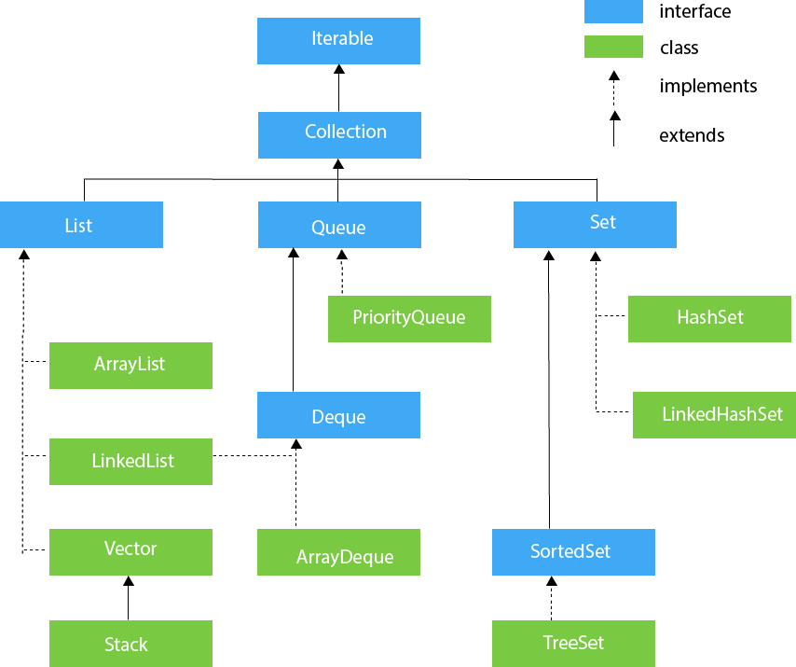
Collections Hierarchy

Slide 25
Collection Interface
It is the interface that is implemented by all the classes in the Collection framework.
It declares the methods that every Java Collection will have. In other words, we can say that the Collection interface builds the foundation on which the collection framework depends.

Slide 26
List Interface
It is a child interface of the Collection interface.
It represents a List type data structure in which we can store an ordered collection of objects.
It can hold duplicate values.
It is implemented by classes such as ArrayList, LinkedList, Vector and Stack among others.

Slide 27
Set Interface
It is an Interface that represents an unordered set of elements.
It doesn't allow us to store duplicate items.
It can hold at most one null value.
It is implemented by classes such as HashSet, LinkedHashSet and TreeSet, among others.

Slide 28
Map Interface
It is an Interface used to store key-value pairs. Each key-value pair is known as an entry.
It contains unique keys.
It is useful if you have to search, update or delete elements based on a key.
It doesn’t extend the Collection Interface, but it’s still a collection because it groups elements of the same type.
It is implemented by HashMap and LinkedHashMap, among others.

Slide 29
Sort Algorithm
It is an algorithm that puts elements of a list in a particular order.
The most-used orders are numerical order and lexicographical order.
Time and Space Complexity is a concept that helps understand the efficiency of any algorithm.

Slide 30
Time and Space Complexity
Time Complexity tells us about the efficiency of an algorithm when the size of the input becomes enormous.
Space Complexity tells us about the storage used by an algorithm when the size of the input becomes enormous.
The complexity is commonly expressed using Big O notation. For instance: O(n), O(n log n), O(n²).
This chapter won't go over about how we can find the Complexity of an algorithm but what it is essential to know is that this concept describes the efficiency of an algorithm.

Slide 31
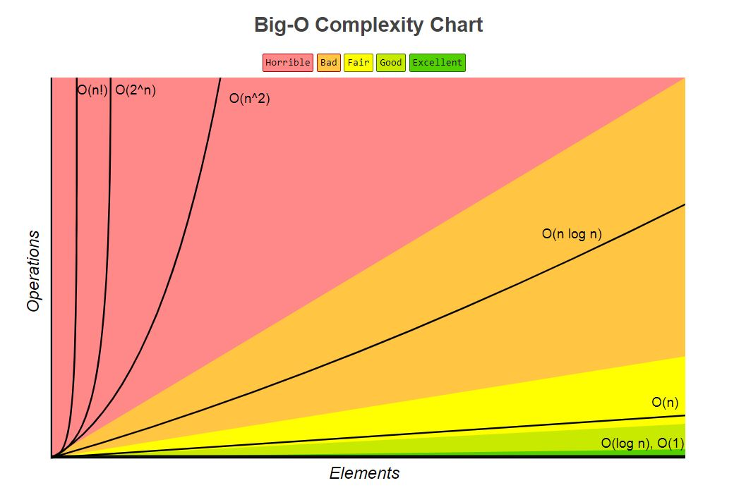
Complexity Chart

Slide 32
Bubble Sort
It is a simple sorting algorithm that works by repeatedly stepping through the list to be sorted.
It compares each pair of adjacent items and swapping them if they are in the wrong order.
Bubble sort has a complexity of О(n2), where “n” is the number of items being sorted.
It is not a practical sorting algorithm when “n” is large.

Slide 33
Merge Sort
It is a divide and conquer algorithm.
It divides the unsorted array into “n” partitions where each partition contains one element. Here the one element is considered as sorted. Repeatedly merge partitioned units to produce new sub lists until there is only one sub list remaining. That will be the sorted list at the end.
It is fast and stable with an O(n log n) efficiency.
Its efficiency is slightly below that of Quick Sort.

Slide 34
Quick Sort
It is a divide and conquer algorithm.
Quicksort first divides a large list into two smaller sub-lists: the low elements and the high elements. Then recursively sort the sub-lists.
It is very fast with an O(n log n) efficiency.
Its efficiency is slightly above that of Merge Sort.

Slide 35
Sort Algorithm used by Java
According to the official documentation, Java uses dual-pivot Quicksort in its java.util.Arrays library.
This algorithm offers O(n log n) performance on many data sets that cause other quicksorts to degrade to quadratic performance.
It is typically faster than the traditional (one-pivot) Quicksort implementation.

Slide 36
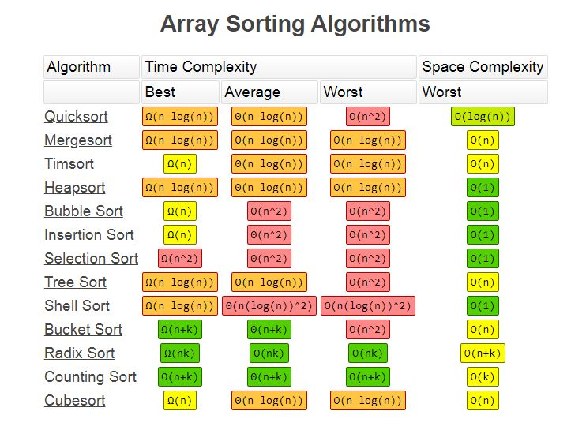
Sort Algorithms Complexities

Slide 37
Search Algorithms
It is an algorithm for finding an item with specified properties among a collection of items.

Slide 38
Linear Search
It is a method for finding a particular value in a list.
It consists of checking every one of its elements, one at a time and in sequence, until the desired one is found.
Linear search is the most straightforward search algorithm.
It has a time complexity of O(n).

Slide 39
Binary Search
It finds the position of a specified value within a sorted array.
In each step, the algorithm compares the input key value with the key value of the middle element of the array. If the keys match, then a matching element has been found so its index, or position, is returned. Otherwise, if the sought key is less than the middle element's key, then the algorithm repeats its action on the sub-array to the left of the middle element or, if the input key is greater, on the sub-array to the right.
The efficiency of this algorithm is O(log n).

Slide 40
Agenda
Autoboxing and Unboxing.
Generics
  Single Type Parameter (Class and Interface).
  Multiple Type Parameter (Class and Interface)
  Raw Type
  Generic Methods
JAVA TRAINING www.busyqa.com/bigdata |www.busyqa.com/online-automation

Slide 41
Autoboxing and Unboxing
Autoboxing is the automatic conversion between the primitive types and their corresponding wrapper classes applied by the Java compiler.
For example, it converts an int to an Integer, a double to a Double, and so on.
If the conversion goes the other way, this is called unboxing.
Available as of Java 5.

Slide 42
Generics
It enables types (classes and interfaces) to be parameters when defining classes, interfaces and methods.
Available as of Java 5.

Slide 43
Generics Naming Conventions
The type parameter names are single uppercase letters.
That stands in sharp contrast to the variable naming conventions that you already know about, and with good reason: Without this convention, it would be difficult to tell the difference between a type variable and a regular class or interface name.
Available as of Java 5.

Slide 44
Type Parameter Names
The most commonly used type parameter names are:
  E - Element (used extensively by the Java Collections Framework)
  K - Key
  N - Number
  T - Type
  V - Value
  S, U, V etc. - 2nd, 3rd, 4th types

Slide 45
Single and Multiple Type Parameter
A Class or Interface could have one or many Type Parameter defined.
A generic class is defined with the following format:
class name<T1, T2, ..., Tn> {
}

Slide 46
Raw Types
A raw type is the name of a generic class or interface without any type arguments. For example, given the generic Box class:
public class Box<T> {
public void set(T t) { /* ... */ }
// …
}
To create a parameterized type of Box<T>, you supply a type argument for the formal type parameter T:
Box<Integer> intBox = new Box<>();
If the type argument is omitted, you create a raw type of Box<T>:
Box rawBox = new Box();

Slide 47
Generic Methods
Are methods that introduce their own type of parameters.
That is similar to declaring a generic type, but the type parameter scope is limited to the method where it is declared.
Static and non-static generic methods are allowed, as well as generic class constructors.

Slide 48
Functional Programming
Definition
Functional Interface
Lambda Expressions
Method Reference
Streams
JAVA TRAINING www.busyqa.com/bigdata |www.busyqa.com/online-automation

Slide 49
Functional Programming
It is a programming paradigm that focuses on the evaluation of mathematical functions to get a computational result.
The mathematical functions are of the form F: A → B where F stands for function, A and B can be a set of variables or functions. (Lambda Expressions)
The main focus is on “what to solve” rather than “how to solve” as in the imperative programming.
It is a declarative paradigm because programming is done with expressions or declarations instead of statements.
It is based on Lambda Calculus, a formal system that provides a theoretical framework for describing functions and their evaluation.
JAVA TRAINING www.busyqa.com/bigdata |www.busyqa.com/online-automation

Slide 50
Functional Interface
It is an Interface that contains exactly one abstract method.
It can have any number of default or static methods but can contain only one abstract method.
It is also known as Single Abstract Method Interfaces or SAM Interfaces.
Java has many built-in Functional Interfaces. They reside in the java.util.function package.
Java also comes with the annotation @FunctionalInterface, which is an informative annotation used to indicate that the interface is intended to be a functional interface.
It is a new feature in Java 8.

Slide 51
Lambda Expressions
It helps us write our code in functional style.
It provides a clear and concise way to implement Functional Interfaces by using an expression.
In simple words, lambda expressions create anonymous methods.

Slide 52
Lambda Expression Components
Has three components:
List of Arguments: It can be empty or non-empty as well.
Arrow-token: It is used to link the list of arguments and body of expression.
Body: It contains expressions and statements for a lambda expression.

Slide 53
Lambda Expression Syntax
No parameter: () -> {
// Body of no parameter lambda
}
One Parameter: (p1) -> {
// Body of single parameter lambda
}
Two Parameter: (p1,p2) -> {
// Body of multiple parameter lambda
}

Slide 54
Method Reference
It is used to refer to a method of functional interface.
It is a compact and easy form of lambda expression. When you are using a lambda expression to refer to a method, you can replace your lambda expression with the method reference.
Lambda expressions are used to create anonymous methods. Sometimes, however, a lambda expression does nothing but call an existing method. In those cases, it's often clearer to refer to the existing method by name. Method references enable you to do this; they are compact, easy-to-read lambda expressions for methods that already have a name.
Java provides a new feature called method reference in Java 8.

Slide 55
Method Reference Types
There are the following types :
  Reference to a static method.
  Reference to an instance method.
  Reference to a constructor.

Slide 56
Streams
Process data in a declarative way, similar to SQL statements.
Represents a sequence of objects from a source, which supports aggregate operations.

Slide 57
Streams Characteristics
It provides a set of elements of a specific type in a sequential manner.
It never stores the elements.
It takes Collections, Arrays, or I/O resources as an input source.
Supports aggregate operations like filter, map, limit, reduce, find, match, and so on.
Most of the stream operations return stream itself so that their result can be pipelined.
Do the iterations internally over the source elements provided, in contrast to Collections, where explicit iteration is required.

Slide 58

Any Questions

